Slide 1
ISTANBUL COMMERCE UNIVERSITY
MARKET STRUCTURES
GENERAL ENGLISH 2 %30 ENGLISH

Slide 2
Market structures:
The analysis of market structures is of great importance when studying
microeconomics. How the market will behave, depending on the number
of buyers or sellers, its dimensions, the existence of entry and exit barriers, etc.
will determine how an equilibrium is reached. Even though market
structures were thoroughly analysed by economists from the early 20th
century on, its study can be traced back to economists such as Antoine
Cournot, Alfred Marshall or even Adam Smith.

Slide 3
A market is a set of buyers and sellers, commonly referred to as agents, who through their interaction, both real and potential, determine the price of a good, or a set of goods. The concept of a market structure is therefore understood as those characteristics of a market that influence the behaviour and results of the firms working in that market.
The main aspects that determine market structures are: the number of agents in the market, both sellers and buyers; their relative negotiation strength, in terms of ability to set prices; the degree of concentration among them; the degree of differentiation and uniqueness of products; and the ease, or not, of entering and exiting the market.

Slide 4
Traditionally, the most important features of market structure are:
The number of firms (including the scale and extent of foreign competition)
The market share of the largest firms (measured by the concentration ratio – see below)
The nature of costs (including the potential for firms to exploit economies of scale and also the presence of sunk costs which affects market contestability in the long term)
The degree to which the industry is vertically integrated - vertical integration explains the process by which different stages in production and distribution of a product are under the ownership and control of a single enterprise. A good example of vertical integration is the oil industry, where the major oil companies own the rights to extract from oilfields, they run a fleet of tankers, operate refineries and have control of sales at their own filling stations.
The extent of product differentiation (which affects cross-price elasticity of demand)
The structure of buyers in the industry (including the possibility of monopsony power)
The turnover of customers (sometimes known as "market churn") – i.e. how many customers are prepared to switch their supplier over a given time period when market conditions change. The rate of customer churn is affected by the degree of consumer or brand loyalty and the influence of persuasive advertising and marketing

Slide 5
COMPETITION
Competition arises whenever at least two parties strive for a goal which cannot be shared: where one's gain is the other's loss
It is, in general, a rivalry between two or more entities: animals, organisms, economic groups, individuals, social groups, etc., for group or social status, leadership, profit, and recognition: awards, goods, mates, prestige, a niche, scarce resources, or a territory.
Competition between companies can be tough, aggressive, even ferocious or cut-throat. Firms may price aggressively in order to build market share, perhaps selling at a loss. They hope to recoup their losses later when, having established themselves to benefit from economies of scale (producing in larger quantities so that the cost of each unit goes down), they are able to charge market prices with a healthy profit margin on each unit sold. This is one way of becoming a cost leader.

Slide 6
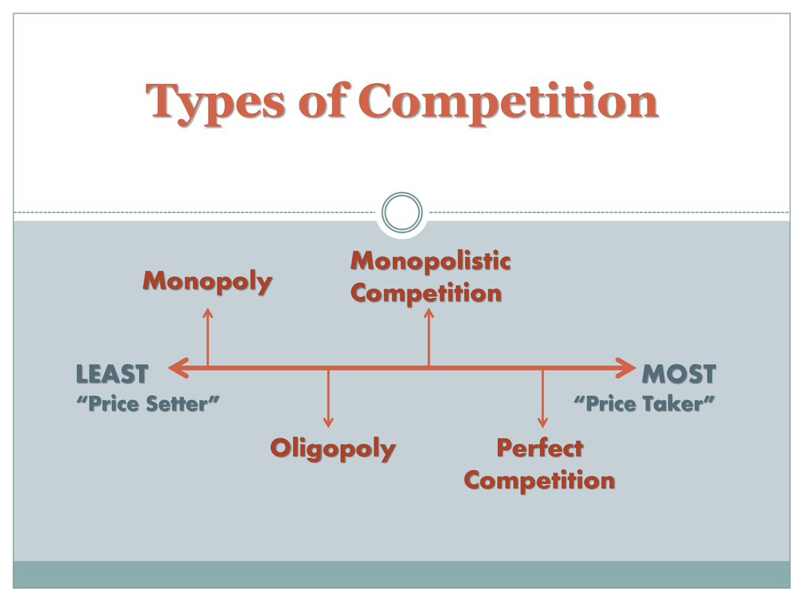
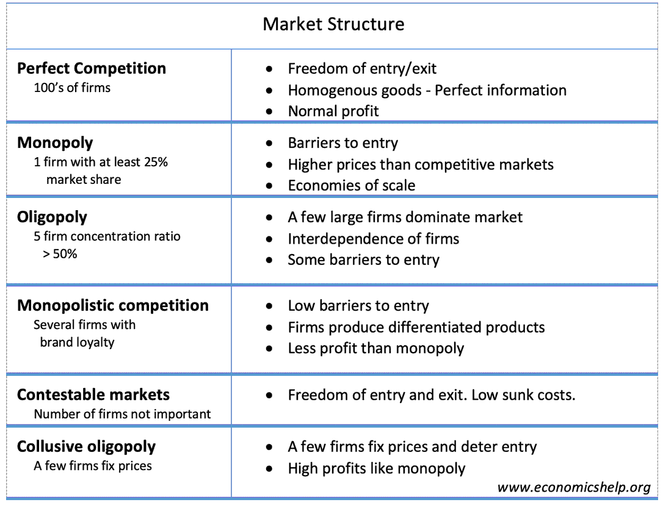
TYPES OF COMPETITION

Slide 7
What Is Perfect Competition?
Pure or perfect competition is a theoretical market structure in which the following criteria are met:
All firms sell an identical product (the product is a "commodity" or "homogeneous").
All firms are price takers (they cannot influence the market price of their product).
Market share has no influence on prices.
Buyers have complete or "perfect" information—in the past, present and future—about the product being sold and the prices charged by each firm.
Resources for such a labor are perfectly mobile.
Firms can enter or exit the market without cost.
[Important: in reality, perfect competition does not exist, but highly competitive and liquid markets for like commodities, such as oil or wheat, are the closest real-world examples.]

Slide 8
HOW IT WORKS
A Large and Homogeneous Market
There are a large number of buyers and sellers in a perfectly competitive market. The sellers are small firms, instead of large corporations capable of controlling prices through supply adjustments. They sell products with minimal differences in capabilities, features, and pricing. This ensures that buyers cannot distinguish between products based on physical attributes, such as size or color, or intangible values, such as branding.
A large population of both buyers and sellers ensures that supply and demand remain constant in this market. As such, buyers can easily substitute products made by one firm for another.

Slide 9
What Is a Monopoly?
A monopoly refers to when a company and its product offerings dominate a sector or industry. Monopolies can be considered an extreme result of free-market capitalism in that absent any restriction or restraints, a single company or group becomes large enough to own all or nearly all of the market (goods, supplies, commodities, infrastructure, and assets) for a particular type of product or service. The term monopoly is often used to describe an entity that has total or near-total control of a market.

Slide 10
Understanding Monopolies
Monopolies typically have an unfair advantage over their competition since they are either the only provider of a product or control most of the market share or customers for their product. Although monopolies might differ from industry-to-industry, they tend to share similar characteristics that include:
High or no barriers to entry: Competitors are not able to enter the market, and the monopoly can easily prevent competition from developing their foothold in an industry by acquiring the competition.
Single seller: There is only one seller in the market, meaning the company becomes the same as the industry it serves.
Price maker: The company that operates the monopoly decides the price of the product that it will sell without any competition keeping their prices in check. As a result, monopolies can raise prices at will.
Economies of scale: A monopoly often can produce at a lower cost than smaller companies. Monopolies can buy huge quantities of inventory, for example, usually a volume discount. As a result, a monopoly can lower its prices so much that smaller competitors can't survive. Essentially, monopolies can engage in price wars due to their scale of their manufacturing and distribution networks such as warehousing and shipping, that can be done at lower costs than any of the competitors in the industry.

Slide 11
Monopolistic Competition
When there are multiple sellers in an industry with many similar substitutes for the goods being produced and companies retain some power in the market, it's referred to as monopolistic competition. In this scenario, an industry has many businesses that offer similar products or services, but their offerings are not perfect substitutes. In some cases, this can lead to duopolies.
In a monopolistic competitive industry, barriers to entry and exit are typically low, and companies try to differentiate themselves through price cuts and marketing efforts. However, since the products offered are so similar between the different competitors, it's difficult for consumers to tell which product is better. Some examples of monopolistic competition include retail stores, restaurants, and hair salons.

Slide 12
What is an Oligopoly?
Oligopoly is a market structure with a small number of firms, none of which can keep the others from having significant influence. The concentration ratio measures the market share of the largest firms. A monopoly is one firm, duopoly is two firms and oligopoly is two or more firms. There is no precise upper limit to the number of firms in an oligopoly, but the number must be low
Oligopoly is when a small number of firms collude, either explicitly or tacitly, to restrict output and/or fix prices, in order to achieve above normal market returns. enough that the actions of one firm significantly influence the others.

Slide 13
Understanding Oligopoly
Oligopolies in history include steel manufacturers, oil companies, rail roads,
tire manufacturing, grocery store chains, and wireless carriers. The
economic and legal concern is that an oligopoly can block new entrants,
slow innovation, and increase prices, all of which harm consumers. Firms in
an oligopoly set prices, whether collectively – in a cartel – or under the
leadership of one firm, rather than taking prices from the market. Profit margins are
thus higher than they would be in a more competitive market.

Slide 14
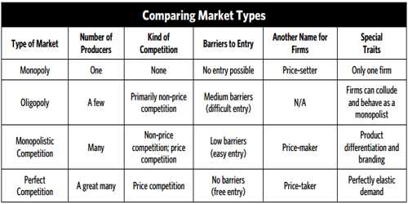

Slide 15
Checklist
https://www.youtube.com/watch?v=9Hxy-TuX9fs
1.there's only one producer for the whole market, ______________________
2.In perfect competition how much market power (where market power is defined as the ability to control the price) does an individual firm have?
3.In perfect competition why are there lots of producers?
.
4.How perfectly competitive market can be recognized?
5.__________________________ is still competitive, so there are still a lot of producers; given there are lots of producers, we can assume that entry into the industry is easy.products are Highly similar, yes; highly substitutable, yes; but not identical.
6. ____________________have a few large producers making up the market, each with a large amount of control, or market power. There are some barriers to entry, so it's hard, but not impossible, to get in.

Slide 16
Vocabulary list
Goal
Feracious
Cut-throat
Market share
Recoup
Economies of scale
Monopoly
Oligopoly
Perfect competition
Monopolistic competition
commodity

Slide 17
Supply
Demand
Dominate
Capitalism
Restraint
Entity
Foothold
Will
İnventory
Warehousing
Shipping

Slide 18
Substitute
Differentiate
Profit margin
TURNOVER
differentiate

