Slide 1
ISTANBUL COMMERCE UNIVERSITY
%30 GENERAL ENGLISH 2
MANAGEMENT & COMPANY STRUCTURE

Slide 2
Management
Management is a set of principles relating to the functions of planning, organizing, directing and controlling, and the application of these principles in harnessing physical, financial, human and informational resources efficiently and effectively to achieve organizational goals.
Fleet and Peterson define management, ‘as a set of activities directed at the efficient and effective utilization of resources in the pursuit of one or more goals.’
Megginson, Mosley and Pietri define management as ‘working with human, financial and physical resources to achieve organizational objectives by performing the planning, organizing, leading and controlling functions‘.

Slide 3
Characteristics of Management

Slide 4
Characteristics of Management
Universal: All the organizations, whether it is profit-making or not, they require management, for managing their activities. Hence it is universal in nature.
Goal Oriented: Every organization is set up with a predetermined objective and management helps in reaching those goals timely, and smoothly.
Continuous Process: It is an ongoing process which tends to persist as long as the organization exists. It is required in every sphere of the organization whether it is production, human resource, finance or marketing.
Multi-dimensional: Management is not confined to the administration of people only, but it also manages work, processes and operations, which makes it a multi-disciplinary activity.
Group activity: An organization consists of various members who have different needs, expectations and beliefs. Every person joins the organization with a different motive, but after becoming a part of the organization they work for achieving the same goal. It requires supervision, teamwork and coordination, and in this way, management comes into the picture.
Dynamic function: An organization exists in a business environment that has various factors like social, political, legal, technological and economic. A slight change in any of these factors will affect the organization’s growth and performance. So, to overcome these changes management formulates strategies and implements them.
Intangible force: Management can neither be seen nor touched but one can feel its existence, in the way the organization functions.

Slide 5
Levels of Management

Slide 6
Top-Level Management: This is the highest level in the organizational hierarchy, which includes Board of Directors and Chief Executives. They are responsible for defining the objectives, formulating plans, strategies and policies.
Middle-Level Management: It is the second and most important level in the corporate ladder, as it creates a link between the top and lower level management. It includes departmental and division heads and managers who are responsible for implementing and controlling plans and strategies which are formulated by the top executives.
Lower Level Management: Otherwise called as functional or operational level management. It includes first line managers, foreman, supervisors. As lower level management directly interacts with the workers, it plays a crucial role in the organization because it helps in reducing wastage and idle time of the workers, improving the quality and quantity of output.
The three management levels form the management hierarchy, that represents the position and rank of executives and managers in the chart.

Slide 7
Functions of Management
Planning: It is the first and foremost function of management, i.e. to decide beforehand what is to be done in future. It encompasses formulating policies, establishing targets, scheduling actions and so forth.
Organizing: Once the plans are formulated, the next step is to organise the activities and resources, as in identifying the tasks, classifying them, assigning duties to subordinates and allocating the resources.
Staffing: It involves hiring personnel for carrying out various activities of the organization. It is to ensure that the right person is appointed to the right job.
Directing: It is the task of the manager to guide, supervise, lead and motivate the subordinates, to ensure that they work in the right direction, so far as the objectives of the organization are concerned.
Controlling: The controlling function of management involves a number of steps to be taken to make sure that the performance of the employees is as per the plans. It involves establishing performance standards and comparing them with the actual performance. In case of any variations, necessary steps are to be taken for its correction.

Slide 8
Types of Management Skills
1. Technical Skills
Technical skills involve skills that give the managers the ability and the knowledge to use a variety of techniques to achieve their objectives. These skills not only involve operating machines and software, production tools, and pieces of equipment but also the skills needed to boost sales, design different types of products and services, and market the services and the products.
2. Conceptual Skills
These involve the skills managers present in terms of the knowledge and ability for abstract thinking and formulating ideas. The manager is able to see an entire concept, analyze and diagnose a problem, and find creative solutions. This helps the manager to effectively predict hurdles their department or the business as a whole may face.
3. Human or Interpersonal Skills
The human or the interpersonal skills are the skills that present the managers’ ability to interact, work or relate effectively with people. These skills enable the managers to make use of human potential in the company and motivate the employees for better results.

Slide 9
Management / leadership styles

Slide 10
1. Democratic Leadership
Commonly Effective
Democratic leadership is exactly what it sounds like -- the leader makes decisions based on the input of each team member. Although he or she makes the final call, each employee has an equal say on a project's direction.
Democratic leadership is one of the most effective leadership styles because it allows lower-level employees to exercise authority they'll need to use wisely in future positions they might hold. It also resembles how decisions can be made in company board meetings.
For example, in a company board meeting, a democratic leader might give the team a few decision-related options. They could then open a discussion about each option. After a discussion, this leader might take the board's thoughts and feedback into consideration, or they might open this decision up to a vote.

Slide 11
2. Autocratic Leadership
Rarely Effective
Autocratic leadership is the inverse of democratic leadership. In this leadership style, the leader makes decisions without taking input from anyone who reports to them. Employees are neither considered nor consulted prior to a direction, and are expected to adhere to the decision at a time and pace stipulated by the leader.
An example of this could be when a manager changes the hours of work shifts for multiple employees without consulting anyone -- especially the effected employees.
Frankly, this leadership style stinks. Most organizations today can't sustain such a hegemonic culture without losing employees. It's best to keep leadership more open to the intellect and perspective of the rest of the team.

Slide 12
3. Laissez-Faire Leadership
The French term "laissez faire" literally translates to "let them do," and leaders who embrace it afford nearly all authority to their employees.
In a young startup, for example, you might see a laissez-faire company founder who makes no major office policies around work hours or deadlines. They might put full trust into their employees while they focus on the overall workings of running the company.
Although laissez-faire leadership can empower employees by trusting them to work however they'd like, it can limit their development and overlook critical company growth opportunities. Therefore, it's important that this leadership style is kept in check.
https://www.youtube.com/watch?v=1AZMiq6Mg-k ( compare 3)

Slide 13
4. Transformational Leadership
Sometimes Effective
Transformational leadership is always "transforming" and improving upon the company's conventions. Employees might have a basic set of tasks and goals that they complete every week or month, but the leader is constantly pushing them outside of their comfort zone.
When starting a job with this type of leader, all employees might get a list of goals to reach, as well as deadlines for reaching them. While the goals might seem simple at first, this manager might pick up the pace of deadlines or give you more and more challenging goals as you grow with the company.
This is a highly encouraged form of leadership among growth-minded companies because it motivates employees to see what they're capable of. But transformational leaders can risk losing sight of everyone's individual learning curves if direct reports don't receive the right coaching to guide them through new responsibilities.

Slide 14
5.Transactional Leadership
Sometimes Effective ( stick and carrot motivation )
Transactional leaders are fairly common today. These managers reward their employees for precisely the work they do. A marketing team that receives a scheduled bonus for helping generate a certain number of leads by the end of the quarter is a common example of transactional leadership.
When starting a job with a transactional boss, you might receive an incentive plan that motivates you to quickly master your regular job duties. For example, if you work in marketing, you might receive a bonus for sending 10 marketing emails. On the other hand, a transformational leader might only offer you a bonus if your work results in a large amount of newsletter subscriptions.
Transactional leadership helps establish roles and responsibilities for each employee, but it can also encourage bare-minimum work if employees know how much their effort is worth all the time. This leadership style can use incentive programs to motivate employees, but they should be consistent with the company's goals and used in addition to unscheduled gestures of appreciation.
https://www.youtube.com/watch?v=ddt_IGMMOrI (compare 2 )

Slide 15
6. Bureaucratic Leadership
Rarely Effective
Bureaucratic leaders go by the books. This style of leadership might listen and consider the input of employees -- unlike autocratic leadership -- but the leader tends to reject an employee's input if it conflicts with company policy or past practices.
You may run into a bureaucratic leader at a larger, older, or traditional company. At these companies, when a colleague or employee proposes a strong strategy that seems new or non-traditional, bureaucratic leaders may reject it. Their resistance might be because the company has already been successful with current processes and trying something new could waste time or resources if it doesn't work.
Employees under this leadership style might not feel as controlled as they would under autocratic leadership, but there is still a lack of freedom in how much people are able to do in their roles. This can quickly shut down innovation, and is definitely not encouraged for companies who are chasing ambitious goals and quick growth.

Slide 16
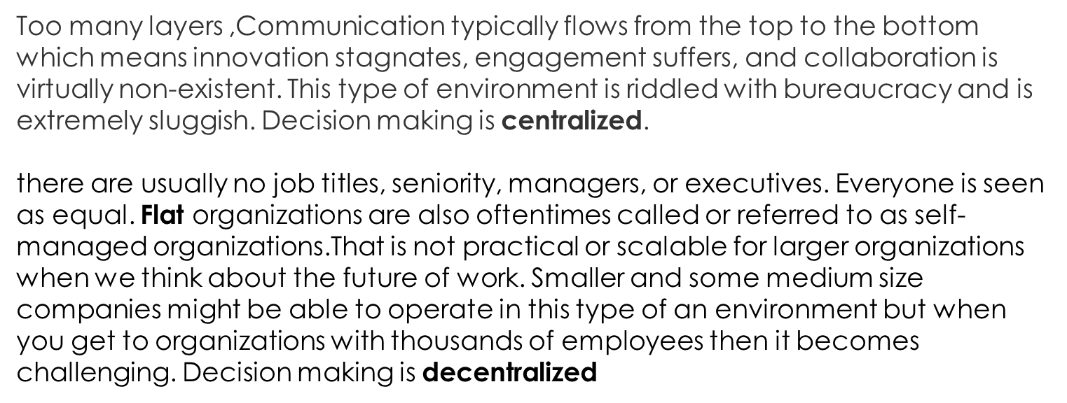
Company structures / Hierarchical vs Flat

Slide 17
Hierarchical vs Flatter

Slide 18
Vocabulary List
Goal
Utilization
Resources
Motive
Supervise/supervision
Overcome
Strategy
Intangible
Hierarch
Policy
Foreman
Output
rank

Slide 19
Vocabulary List
Task
Superior
Subordinate
Allocate
Appoint
Boost
Diagnose
Hurdle
Democratic
Authority

Slide 20
Vocabulary list
Consult
Adhere to
Stipulate
Shift
Hegemonic
Deadline
Reward
Incentive
Bureucratic
Centralize
Decentralized
initiative

