Slide 1
HYPOTHESIS TESTING

Slide 2
In the experiment we want to test the hypothesis that people who are in a good mood perform better on an intelllectual tasks than people who are in a neutral mood. To test these hypothesis we create two conditions : In one condition, a group of participants watch a movie exerpt with humerous content. And in the other condition, a different group of participants in the experimental condition watch an excerpt with an emotionally neutral content. We expect that , participants in the experimental condition will perform better on an intellectual task than those in the control condition. Because of a mood change induced by the experimental condition The level of intellectual performance is measured by presenting participants with 10 logical problems. To decide if our hypothesis is correct we must count the number of logical problems solved by participants in each condition of the experiment.
Now, suppose that participants in the experimantal condition, generally solve more problems than those in the control condition . This indicates that our hypothesis might be correct . However , finding that, participants in the experimental condition tend to solve more problems than those in the control condition is insufficient to lead us the conclusion that mood has a really effect on intellectual performance . We need to use procedures taht can ensure that random means are not possible for differences between scores in the experimental and control conditions. Put differently, we need to deal with our data in a way that will allow to infer whether scores in the two conditions are sufficiently different to justify the conclusion that the hypothesis is correct. The procedures concern the domain of statistical inference.

Slide 3
Parametric Test
Nonparametric Tests
Hypothesis Testing

Slide 4
Hypothesis Testing
One Sample t- Test
Two Sample Tests
k-sample Test (Analysis of variance-ANOVA)
Independent Sample t -Test
Paired Sample t- Test
H_{O}=Null hypothesis
H_{a}=Alternative hypothesis
One Tailed Hypothesis for one sample t -test
H_{O}:µ=10
H_{a}:µ<10 or >10
Two Tailed Hypothesis for one sample t- test
H_{O}:µ=10
H_{a}:µ≠10
Decision:
Reject the null hypothesis
Fail to reject the null hypothesis

Slide 5
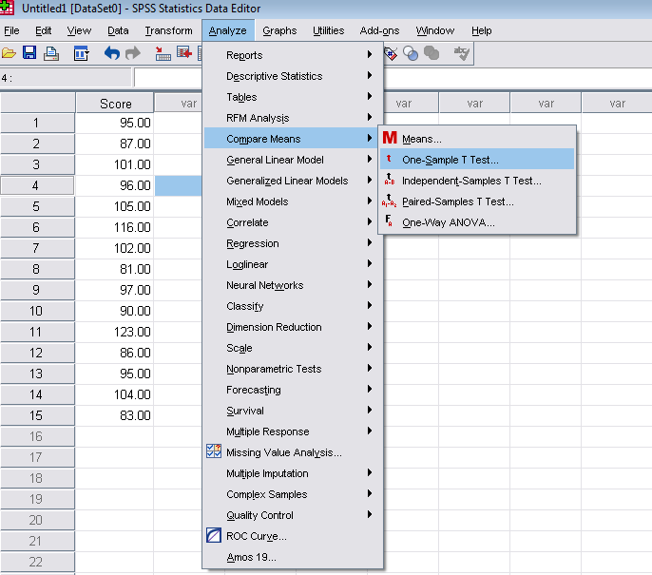
Data: This is hypothetical data for a one sample design IQ scores of sample of ten year old children.
The mean IQ of the UK population of ten year old is often set at 100 with more intelligent children having scores ranging above 100 and less intelligent children having scores ranging below 100. If we wanted to establish whether a sample of ten year old whom we intended to use in an experiment were typical of the Uk Population of 10 years old. We would test the IQ’s of our sample against the known mean of 100.
H_{O}:µ=100
H_{a}:µ≠100

Slide 6
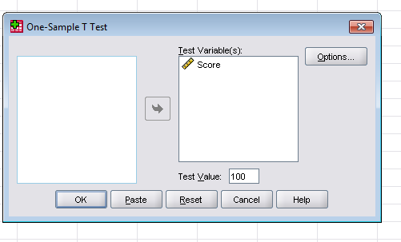

Slide 7
Reporting Results of one sample t test,
The way the result would be described in a report of the study. (Assuming that alpha was set at 0,05 and a two-tailed test had been decided on) would be something like this;
In a one sample t -test of the hypothesis that the mean IQ of a sample of 10 year old would differ from the population mean of 100 , the sample mean of 97.40 did not differ significantly from the population mean (t=--0,86; p>0,05). It is thefore reasonable to treat the sample as representative of the population with respect to IQ.

