Slide 1
THE RIPHAH CENTRE OF ISLAMIC BUSINESS 5 th INTERNATIONAL CONFERENCE ON ISLAMIC BUSINESS
ISLAMIC FINANCE :
The Need & Prospects of Moving to Social Finance

Slide 2
RESPONSIBLE FINANCE Meeting Point between Islamic Finance and Conventional Finance
Prof.Dr. Necdet Şensoy
Istanbul Commerce University
Research Center for Islamic Economics and Economic Systems

Slide 3
MAIN STREAM RESPONSIBLE ISLAMIC FINANCE FINANCE FINANCE (Conventional)

Slide 4
ECONOMIC PARADOXES
Growth versus Environmental Sensitivity
Greed versus Conscience
Profit maximization versus Social Responsibility
Trade off ??

Slide 5
FINANCE – Evolution
Capitalism
Wild Capitalism
Moral Capitalism
Ethical Finance
Green Finance
Islamic Economics and Finance
Elimination of Riba
Refrain from non-halal business
Sensivity to environment
Respect to human resources

Slide 6
Conscience Emerges
U.N. SUSTAINABLE DEVELOPMENT GOALS
ESG : Environmental, Social,Governance
PRI INITIATIVE : Principles of Responsible Investment
Sustainability Accounting Standards Board
Global Reporting Initiative
Sustainability Reporting
Integrated Reporting

Slide 7
U.N. SUSTAINABLE DEVELOPMENT GOALS
the 17 SDGs of the 2030 agenda of
«Sustainable Development»
adopted by world leaders in
Septemner 2015 at UN Summit,
officially came into force
On Jan.1,2016

Slide 8
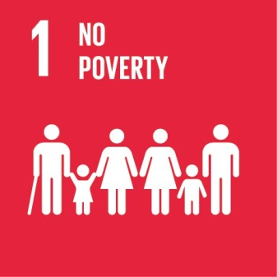
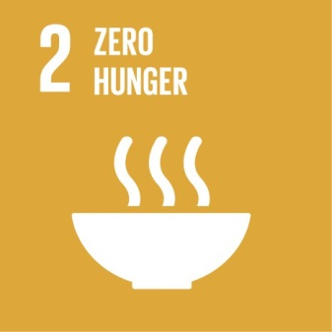
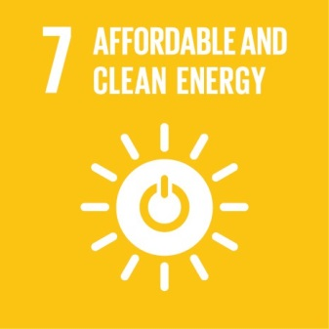
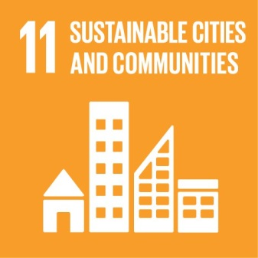
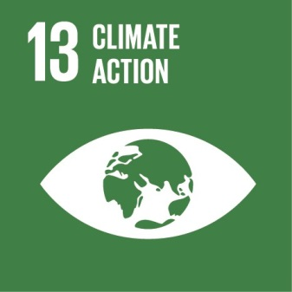
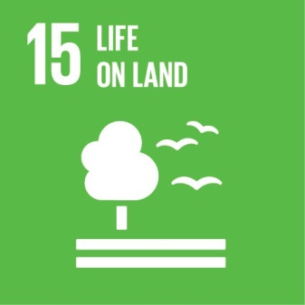

Slide 9
What is Responsible Investment (RI)?
•RI incorporates an active consideration of environmental, social and corporate governance (ESG) factors within investment decision making and ownership practices.
•What is ESG?
–ESG is an acronym, used globally, describing the so-called corporate governance triple bottom line, namely environment, social matters and governance.
•What is the objective of the UN PRI?
–To implement a set of global principles that facilitates the integration of environmental, social and governance (ESG) factors into mainstream investment decision-making and ownership practices.

Slide 10
SELECTIVE INVESTORS & FUNDS
Ethical Finance
Funds seeking ESG sensitive, socially resposible companies
are increasing in investment market
Islamic Finance
Those criteria required by ethical finance investors are almost fitting to
« Principles of Islamic Finance»

Slide 11
Go Green
ETHICAL FINANCE- Green Bond
Islamic Finance - Green Sukuk
USD 47.9 bn of green bond issuance
42% growth on Q 1 2018
Green Sukuk Issuance
Allocation and Impact Report
Feb2019
sdgphilanhropy.org

Slide 14
Turkish Industrial Development Bank TSKB
Issued first sustainable
«SUKUK IJARA» (= Lease Certificate of TURKEY
in May 2020
On behalf of ZORLU ENERGY ( USD 65 million )
This is third issuance after
1- natural gas distribution
2- food industry

Slide 17
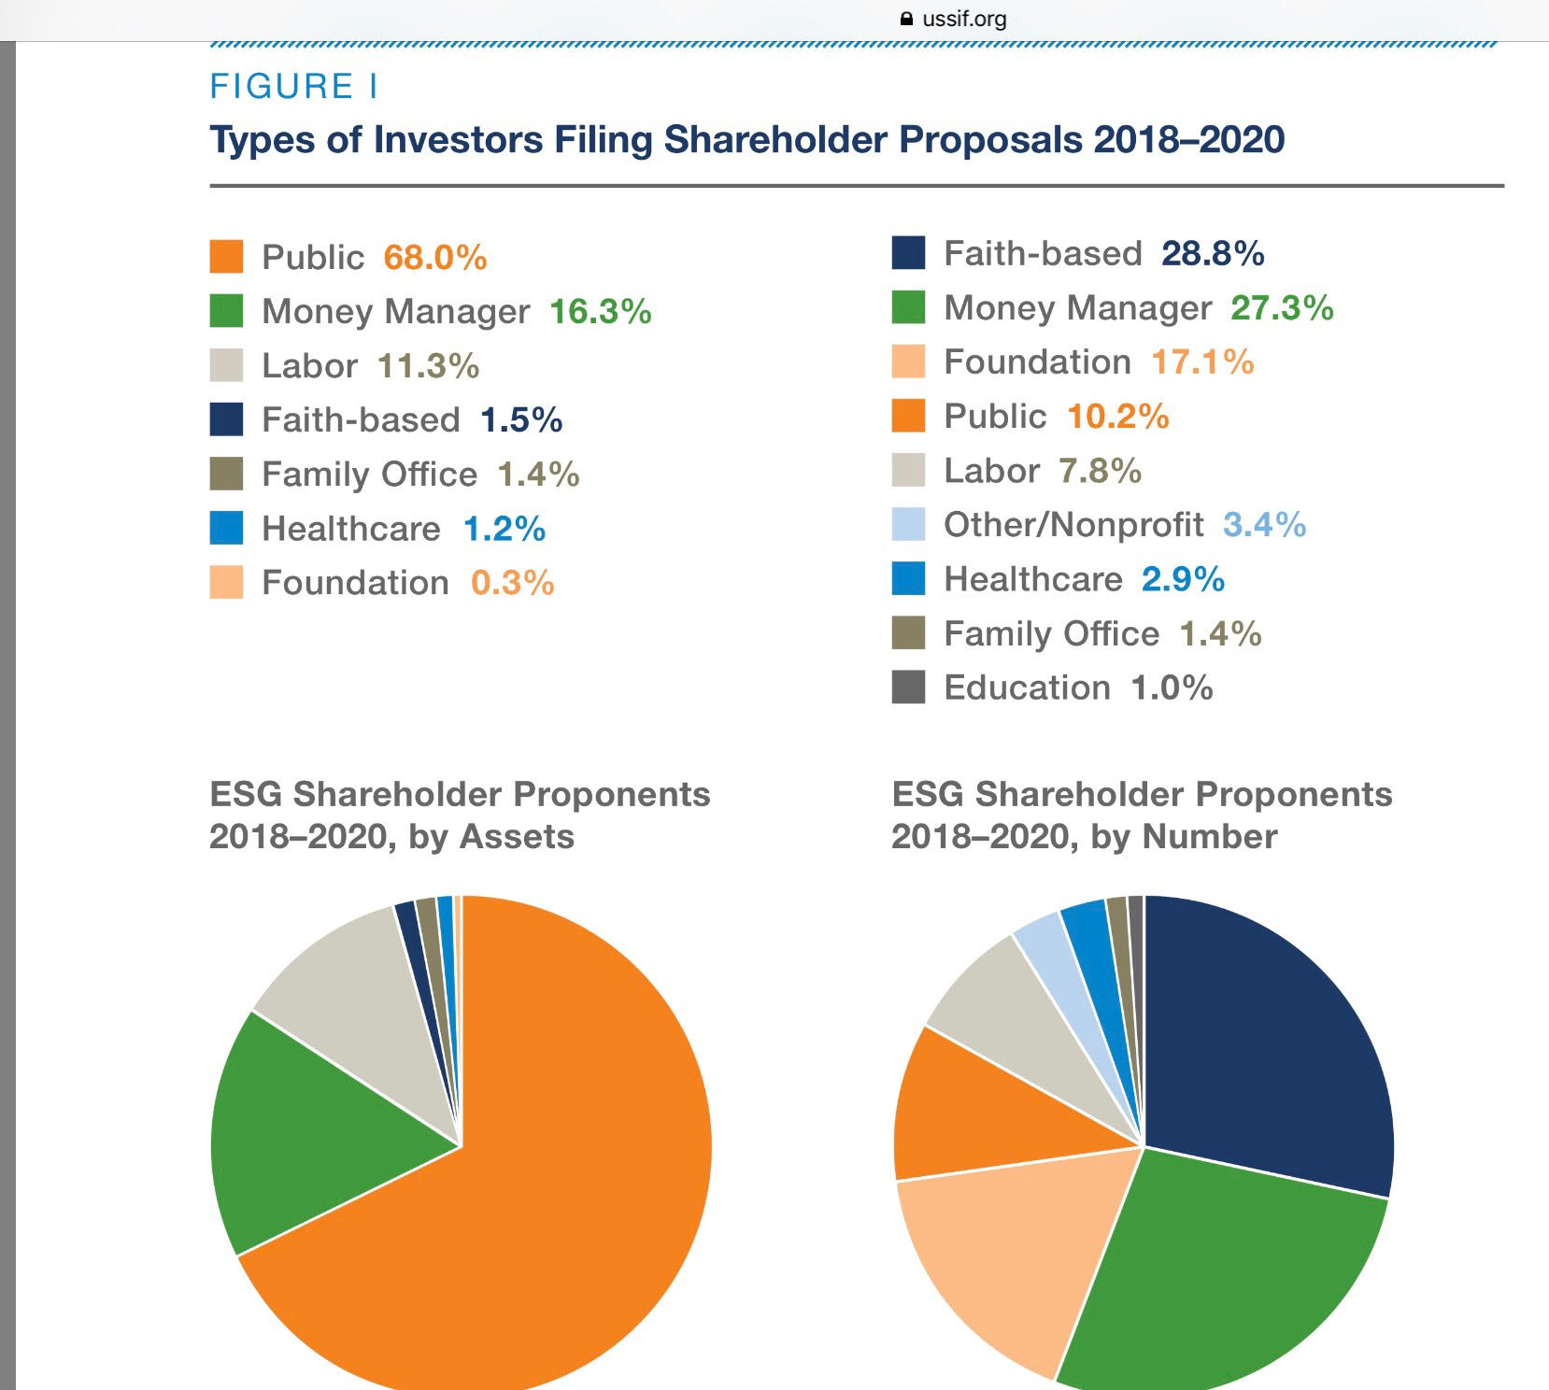

Slide 18
Maqasid al Sharia Objectives of Islamic Law
Developed since early islamic era
Contemporary Researchers on Islamic Finance refers to this concept very frequently

Slide 19
Everything that is considered necessary to preserve and enrich :
Faith,
Life,
Intellect,
Posterity and
Wealth
Whatever ensures the safeguarding of these five,
Serves public interest and it is Desireable
( al-Ghazali )

Slide 20
GROUPING THE U.N. SUSTAINABLE DEVELOPMENT GOALS UNDER MAQASID AL SHARIA
Faith : Indifferent
Life : No poverty, Zero Hunger, Good health and wellbeing, sustainable cities and communities
Intellect : Peace, Justice and Strong Institutions, Reduced Inequalities
Posterity : Quality Education, Clean Water and Sanitation, Climate Action, Life below Water, Life on Land, Gender Equality
Wealth : Decent work & economic Growth, Industry, Innovation & Infrastructure, Affordable and Clean Energy

Slide 21
Do Economics & Finance help safeguarding of these five ?
For example: To Preserve and Enrich Faith
- “MAKE INFERENCE”
Fraud can be considered as a sin.
Sin damages ( cover ) Faith.
Regulations to prevent Fraud
safeguards Faith
( ie.COSO Control Environment)

Slide 22
To Preserve and Enrich Life and Intellect
Everything done to ensure;
Adequate Nutrition,
Clothing,
Proper upbringing and education for spiritual development,
Housing , A Healthy spiritual and physical environment,
Medical Facilities, Comfortable transport
( Chapra,p.8 )

Slide 23
Posterity = offspring
«Preserve and protect rights of future generations»
The following are not complying :
Transferring debt obligations to future generations
Transferring degraded environment to the future generations
Tariqullah Khan,
www.linkedin.com/pulse/ethics-islamic-finance-tariqullah-khan

Slide 24
To Preserve and Enrich Wealth
Economics focus on Acqisition of Wealth
Finance focus on Management, maintenance and increase of wealth

Slide 25
Falah & Hayat Tayyibah;
To achieve Falah & Hayat Tayyibah,
Economic Development is necessary
which is “mostly qualitative” .
As well as Economic Growth
which is “purely quantitative”.

Slide 26
Economic and Social Development
Economic and Social Development
provides opportunity for :
Education and health,
Rule of Law
Equatible Distribution of Income & Wealth.”

Slide 27
ISLAMIC FINANCE
Helps Preserve and enrich
Wealth

Slide 28
Protect the Life

Slide 29
Protect the Posterity

Slide 30
Protect the Wealth

Slide 31
Convergence of Islamic Finance to Sustainabilty Standards
CIBAFİ «Environmental&Social Responsibility Award»
Institute of Responsible Finance Foundation

Slide 32
Enhance Social Responsibilty in Islamic Banks
Set environmentally friendly policies, procedures and Business Practices
Monitor customers compliance with environmental standards
Support phlianthropic and social programmes
Observe and care impact of environmental and social activities

Slide 33
Enhance Social Responsibilty in Islamic Banks
Set environmentally friendly policies, procedures and Business Practices
Monitor customers compliance with environmental standards
Support phlianthropic and social programmes
Observe and care impact of environmental and social activities

Slide 34
CONCLUSION
Wisdom is common for all humanity,
Merits of conventional finance and business as caring environment and being socially responsible is also virtue of Islamic Banking and Finance

Slide 35
THANKS….

Slide 36
ww4.ticaret.edu.tr/islamekonomisi ve Ekonomik sistemler uygulama ve araştırma merkezi
necdetsensoy@ticaret.edu.tr
https://marmara.academia.edu/necdetsensoy

