Slide 1
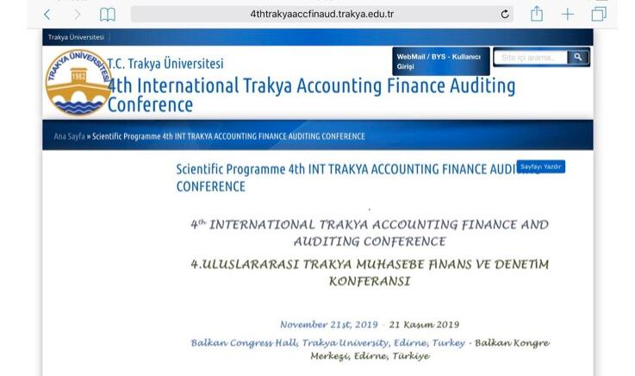

Slide 2
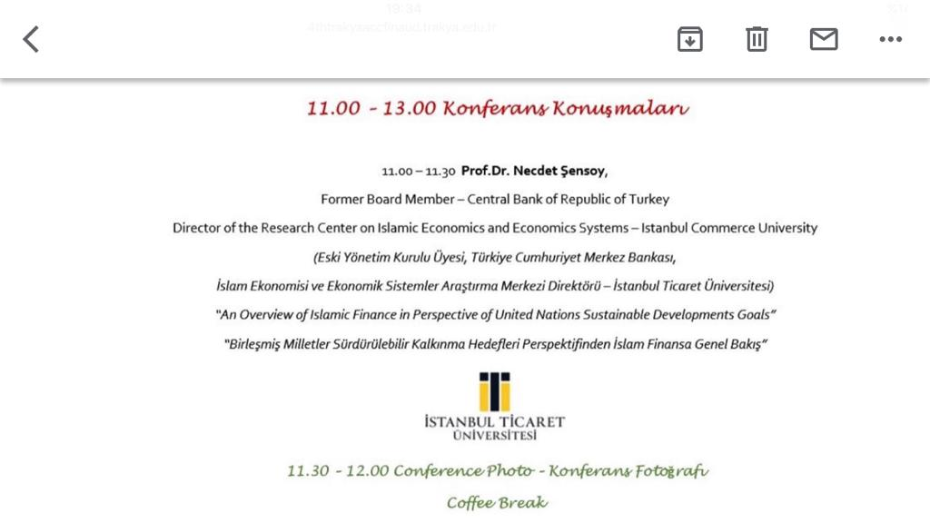

Slide 3
AN OVERVIEW OF ISLAMIC FINANCE IN PERSPECTIVE OF UNITED NATIONS SUSTAINABLE DEVELOPMENT GOALS
21 November 2019
Prof. Dr. Necdet Sensoy
Istanbul Commerce University
Faculty of Business Administration

Slide 4
Topics to be covered
Background of developments
UN Sustainable Development Goals
Principles for Responsible Investment
Sustainability Accounting & Reporting
Global Reporting Initiative ( GRI )
Maqasid Al Sharia
Responsible Finance Institute Foundation
Compatibility of Islamic Finance to Sustainability Standards
Conclusion

Slide 5
Background of developments

Slide 6
ECONOMIC PARADOXES
Growth versus Environmental Sensitivity
Greed versus Conscience
Profit maximization versus Social Responsibility
Trade off ??

Slide 7
FINANCE – Evolution
Capitalism
Wild Capitalism
Moral Capitalism
Ethical Finance
Green Finance
Islamic Economics and Finance
Elimination of Riba
Refrain from non-halal business
Sensivity to environment
Respect to human resources

Slide 8
SELECTIVE INVESTORS & Funds
Ethical Finance in US
Funds seeking ESG sensitive, socially resposible companies
are increasing in investment market
Islamic Finance in US
i.e. Azzad Asset Management
www.azzadfunds.com

Slide 9
Go Green
ETHICAL FINANCE- Green Bond
Islamic Finance - Green Sukuk
USD 47.9 bn of green bond issuance ( 42% growth on Q 1 2018)
According to the US SIF Foundation’s 2018 report «US sustainable, Responsible and Impact investing Trends» more than one out of four dollars under professional management invested according to SRI strategies ( 12 trillion $ or more )
www.ussif.org
In March 2018 The Government of Indonesia issued US $ 1.25 billion
Green Sukuk Issuance
Allocation and Impact Report
Feb2019
sdgphilanthropy.org

Slide 10
Conscience Emerges
U.N. SUSTAINABLE DEVELOPMENT GOALS
ESG : Environmental, Social,Governance
PRI INITIATIVE : Principles of Responsible Investment
Sustainability Accounting Standards Board
Global Reporting Initiative
Sustainability Reporting
Integrated Reporting

Slide 11
Parallel Trends
Conventional Finance
Islamic Finance
UN-SDG
Principles of Responsible Investment
Sustainability Accounting Standards Board
Global Reporting Initiative
Maqasid al Sharia
Responsible Finance Institute Foundation
Socially Responsible Investment and The Case for Islamic Investment

Slide 12
CONVENTIONAL FINANCE
By Conscience

Slide 13
U.N. SUSTAINABLE DEVELOPMENT GOALS
The 2030 Agenda for Sustainable Development
17 Goals of Sustainable Development
adopted by world leaders in September 2015 at UN Summit, officially came into force
by Jan.1,2016

Slide 14







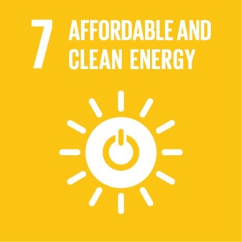











Slide 15
What is Responsible Investment (RI)?
•RI incorporates an active consideration of environmental, social and corporate governance (ESG) factors within investment decision making and ownership practices.
•What is ESG?
–ESG is an acronym, used globally, describing the so-called corporate governance triple bottom line, namely environment, social matters and governance.
•What is the objective of the UN PRI?
–To implement a set of global principles that facilitates the integration of environmental, social and governance (ESG) factors into mainstream investment decision-making and ownership practices.

Slide 16
How can RI create investment value?
•RI helps identify ESG-related risks as well as opportunities
•Lengthening the investment horizon can enhance long-term value
•Strong ESG performance can result in new opportunities and reduced risks for investee firms
•Macro issues such as climate change or corruption can impact performance of the economy as a whole and are therefore material to entire portfolios
•Active ownership is important to protect and strengthen investments

Slide 17
WHAT IS THE PRI
Principles of Resonsible Investment
The PRI is the world's leading proponent of responsible investment.
It works to understand the investment implications of environmental, social and governance (ESG) factors and to support its international network of investor signatories in incorporating these factors into their investment and ownership decisions.
The PRI acts in the long-term interests of its signatories, of the financial markets and economies in which they operate and ultimately of the environment and society as a whole.
The PRI is truly independent. It encourages investors to use responsible investment to enhance returns and better manage risks, but does not operate for its own profit; it engages with global policymakers but is not associated with any government;
PRI is supported by, but not part of, the United Nations.

Slide 18
PRI www.unpri.org
A tool kit for integrating ESG issues into mainstream investment practices and across asset classes
Grounded in fiduciary duty
Voluntary and aspirational
A global collaborative investor network
A forum for discussion and concrete action on long-term risk issues and value drivers
A secretariat providing practical guidance on emerging ESG issues and implementation support for signatories

Slide 19
The six Principles for Responsible Investment are a voluntary and aspirational set of investment principles that offer a menu of possible actions for incorporating ESG issues into investment practice.
The Principles were developed by investors, for investors. In implementing them, signatories contribute to developing a more sustainable global financial system.
They have nearly 1,700 signatories, from over 50 countries, representing US$62 trillion.

Slide 20
The six Principles for Responsible Investment
Principle 1
We will incorporate ESG issues into investment analysis and decision-making processes.
Principle 2
We will be active owners and incorporate ESG issues into our ownership policies and practices.
Principle 3
We will seek appropriate disclosure on ESG issues by the entities in which we invest.
Principle 4
We will promote acceptance and implementation of the Principles within the investment industry.
Principle 5
We will work together to enhance our effectiveness in implementing the Principles.
Principle 6
We will each report on our activities and progress towards implementing the Principles.

Slide 21
Sustainability Accounting Standards Board (SASB)
an independent non-profit organization
19 members
develops sustainability accounting standards which are for voluntary use in disclosures

Slide 22
FiveBroad Sustainability Dimensions
By SASB

Slide 23
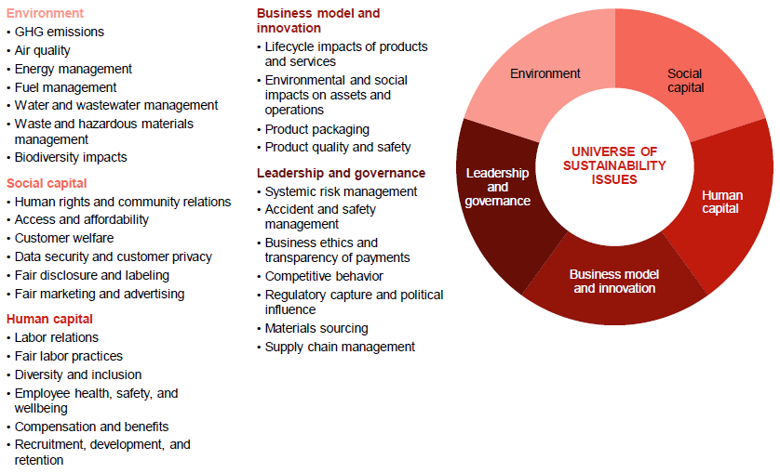

Slide 24
Sustainability / Sustainability Accounting
Sustainability:
corporate activities that maintain or enhance the ability of the company to create value over the long term.
Sustainability Accounting:
the measurement, management, and reporting of such corporate activities.

Slide 25
Social Capital
Business is expected to contribute to society in return for a social license to operate
human rights,
protection of vulnerable groups,
local economic development,
access to and quality of products and services,
affordability,
responsible business practices in marketing
customer privacy

Slide 26
Human Capital
HR are key assets to delivering long-term value
Health and safety of employees
Employee engagement
Diversity
Incentives and compensation

Slide 27
USING THE GUIDELINES
TO PREPARE A SUSTAINABILITY REPORT:
THE STEPS TO FOLLOW

Slide 28
PREPARE TO DISCLOSE GENERAL STANDARD DISCLOSURES
Identify the General Standard Disclosures required for the chosen ‘in accordance’ option
Check if there are General Standard Disclosures that apply to the organization’s sector. The GRI Sector Disclosures can be found at www.globalreporting.org/reporting/sector-guidance
Read the Principles for Defining Reporting Quality
Plan the processes to disclose the General Standard Disclosures
Consult the information presented in the Implementation Manual for explanations of how to disclose the General Standard Disclosures
Dedicate adequate time and attention to complete the General Standard Disclosures under the section ‘Identified Material Aspects and Boundaries’ (pp. 28-29). These General Standard Disclosures are a central element of both ‘in accordance’ options, and should be disclosed for both. To do this: Read the Principles for Defining Report Content (pp. 16-17)
Read the three steps for defining material Aspects and Boundaries, presented in the Implementation Manual (pp. 31-40), and use the visual support for these steps (p. 90)

Slide 29
PREPARE TO DISCLOSE SPECIFIC STANDARD DISCLOSURES
Specific Standard Disclosures are Disclosures on Management Approach (DMA) and Indicators. They are presented under Categories and Aspects, as displayed in Table 1 on the next page
Identify the DMA and Indicators related to the material Aspects
Check if there are Aspects and Specific Standard Disclosures that apply to the organization’s sector. The Sector Disclosures can be found at www.globalreporting.org/reporting/sector-guidance
Read the Principles for Defining Reporting Quality (pp. 17-18)
Plan the necessary processes to disclose the Specific Standard Disclosures. The report should cover DMA and Indicators for identified material Aspects (pp. 62-235 of the Implementation Manual). Aspects that are not identified as material do not need to be covered in the report
Consult the information presented in the Implementation Manual for explanations of how to disclose the Specific Standard Disclosures
Information on topics considered material by the organization but not covered by the GRI Aspects list can also be included

Slide 30
PREPARE THE SUSTAINABILITY REPORT
Present the information prepared
Electronic or web-based reporting and paper reports are appropriate media for reporting. Organizations may choose to use a combination of web and paper-based reports or use only one medium. For example, the organization may choose to provide a detailed report on its website and provide an executive summary, including its strategy and analysis and performance information, in paper form. The choice will likely depend on the organization’s decisions on its reporting period, its plans for updating content, the likely users of the report, and other practical factors, such as its distribution strategy
At least one medium (web or paper) should provide users with access to the complete set of information for the reporting period
In case of unintended discrepancies between the first part Reporting Principle and Standard Disclosures and the second part Implementation Manual, the first part contains the authoritative text and shall apply.

Slide 31
ISLAMIC FINANCE
Its intrinsic value

Slide 32
Maqasid al Sharia
Objectives of Islamic Law
Developed since early islamic era
Contemporary Researchers on Islamic Finance refers to this concept very frequently

Slide 33
preserve and enrich :
Faith,
Life,
Intellect,
Posterity and
Wealth
Whatever ensures the safeguarding of these five,
Serves public interest and it is Desireable
( al-Ghazali )

Slide 34
MAQASİD AND THE GLOBALGOALS FOR SUSTAINABLE DEVELOPMENT
Faith :
Life : No poverty, Zero Hunger, Good health and wellbeing, sustainable cities and communities
Intellect, Peace, Justice and Strong Institutions, Reduced Inequalities
Posterity : Quality Education, Clean Water and Sanitation, Climate Action, Life below Water, Life on Land, Gender Equality
Wealth : Decent work & economic Growth, Industry, Innovation & Infrastructure, Affordable and Clean Energy

Slide 35
Do Economics & Finance help safeguarding of these five ?
For example: To Preserve and Enrich Faith
- “MAKE INFERENCE”
Fraud can be considered as a sin.
Sin damages ( cover ) Faith.
Regulations to prevent Fraud
safeguards Faith
( ie.COSO Control Environment)

Slide 36
To Preserve and Enrich
Life and Intellect
Everything done to ensure;
Adequate Nutrition,
Clothing,
Proper upbringing and education for spiritual development,
Housing , A Healthy spiritual and physical environment,
Medical Facilities, Comfortable transport
( Chapra,p.8 )

Slide 37
Posterity = offspring
«Preserve and protect rights of future generations»
The following are not complying :
Transferring debt obligations to future generations
Transferring degraded environment to the future generations
Tariqullah Khan,
www.linkedin.com/pulse/ethics-islamic-finance-tariqullah-khan

Slide 38
To Preserve and Enrich Wealth
Economics focus on Acqisition of Wealth
Finance focus on Management, maintenance and increase of wealth

Slide 39
Falah & Hayat Tayyibah;
To achieve Falah & Hayat Tayyibah,
Economic Development is necessary
which is “mostly qualitative” .
As well as Economic Growth
which is “purely quantitative”.

Slide 40
Economic and Social Development
Economic and Social Development
provides opportunity for :
Education and health,
Rule of Law
Equatible Distribution of Income & Wealth.”

Slide 41
ISLAMIC FINANCE
Helps Preserve and enrich
Wealth

Slide 42
Protect the Life

Slide 43
Protect the Posterity

Slide 44
Protect the Wealth

Slide 45
Convergence of Islamic Finance to Sustainabilty Standards
CIBAFİ «Environmental&Social Responsibility Award»
Institute of Responsible Finance Foundation

Slide 46
Responsible Finance Institute Foundation rfi-foundation.org
THE ISLAMIC FINANCE ESG REPORT
Provides insights into the commonalities between ESG & Islamic Finance investing,
using a specialized screening methodology to highlight ESG related risks with islamic investments

Slide 47
RFI Foundation & IFSB
RESPONSIBLE FINANCE
Ethical and Islamic Finance
Meeting the Global Agenda

Slide 48
Responsible Finance-Ethical & Islamic
Finance and Serving Economy
Finance and Bringing Value to Society
Finance and Environmental Sustainability
Ethical Aspects of Finance
Responsible Finance and Financial Stability

Slide 49
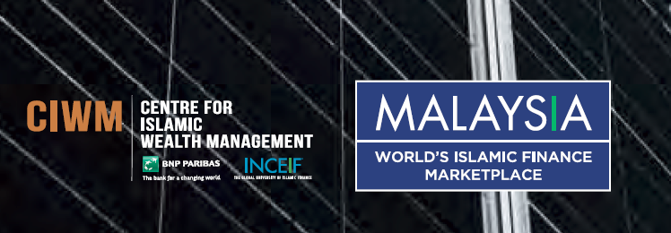
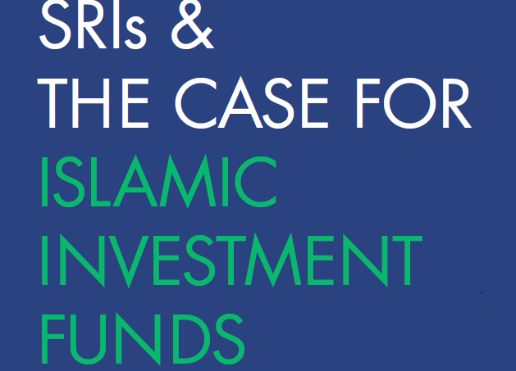

Slide 50
The Islamic Proposition to SRIs (1)
A reduction in uncertainty and in leverage levels in the business community;
Establishing a level playing field through reasonable profit-taking and equitable bargaining power for transacting parties;
Maintaining stability by removing of business operations based on speculative ends;

Slide 51
The Islamic Proposition to SRIs (2)
Eradication of business activities that have destructive objectives on men and nature for the sake of continued and assured economic stability for future generations;
Promoting sustainable business and investment activities that entail positive results with stable future prospects and the welfare of men and the societies they live in;

Slide 52
The Islamic Proposition to SRIs (3)
Stimulating entrepreneurial vision, trade and industry growth based on sound relationships that span industries, suppliers and customers and on mechanisms that channel wealth and assets originating from capital owners, savings and charitable funds to achieve profits.

Slide 53
The Islamic Proposition to SRIs (3)
All this is achieved while providing opportunities for success for those seeking to improve their circumstances.
This approach reduces the isolated nature of conventional saving and investment schemes;

Slide 54
The Islamic Proposition to SRIs (4)
Linking capital markets to real economic activities where capital owners and financial institutions become buyers, sellers and partners instead of creditors. This translates in a more active business environment where investors take part in clearly specified businesses and transactions;

Slide 55
The Islamic Proposition to SRIs (5)
As a result of all of the above, greater stability builds its way into the economies of nations, ensuring socio-economic wellbeing and spurs growth in a tenable manner that can be seen in carefully choosing business activities anchored in Sharia and characterised by long term perspectives.

Slide 56
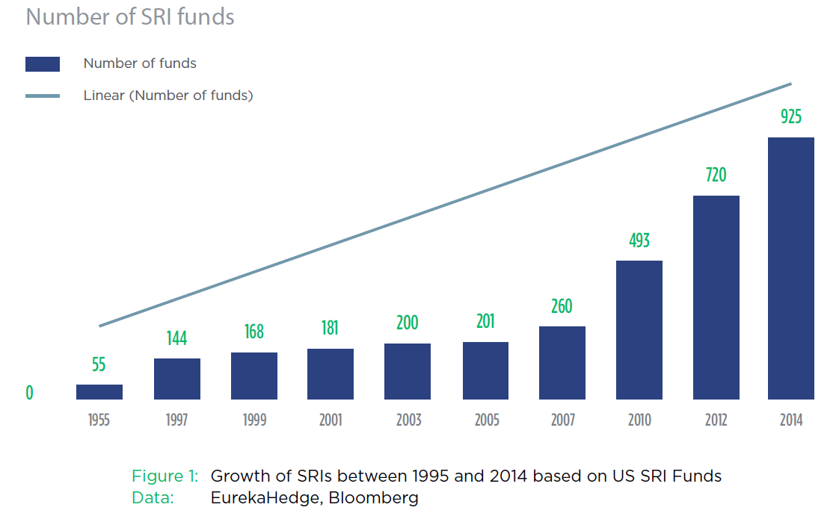

Slide 57
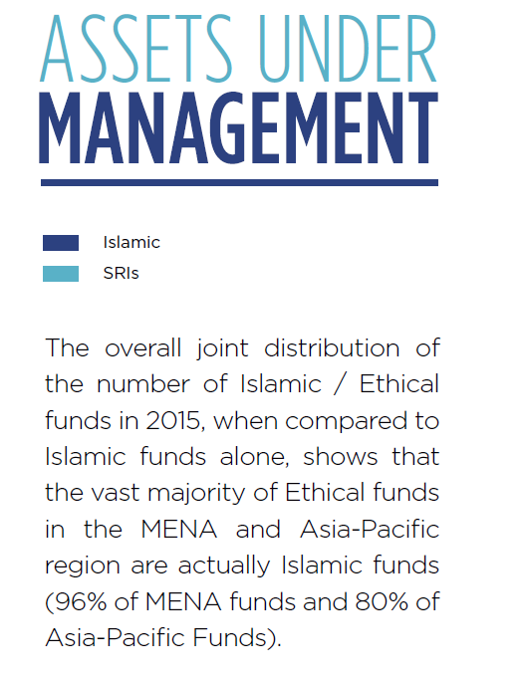

Slide 59
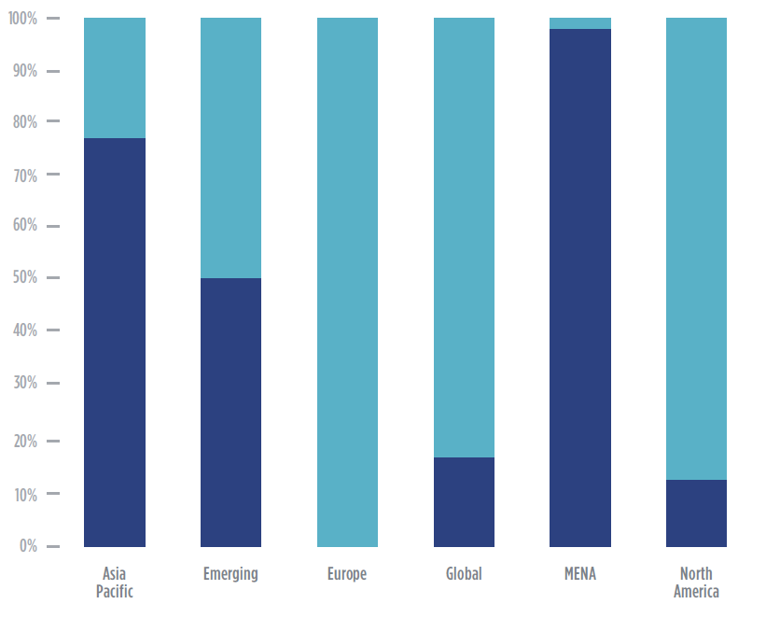

Slide 60
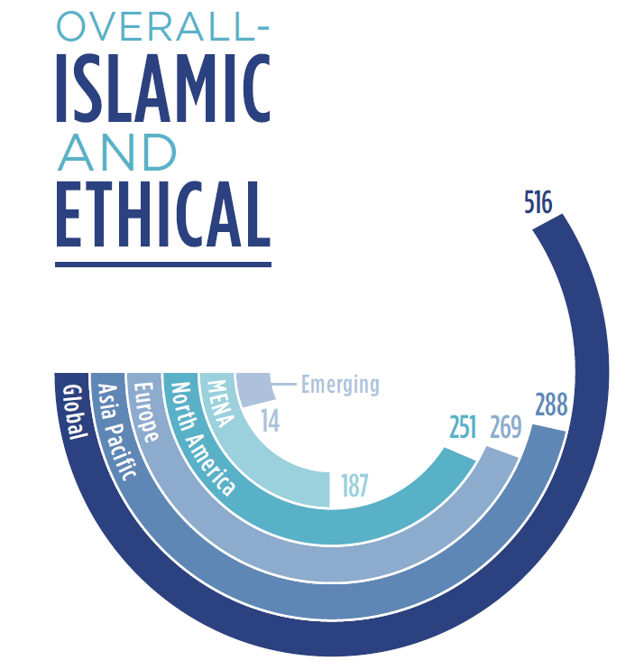

Slide 61
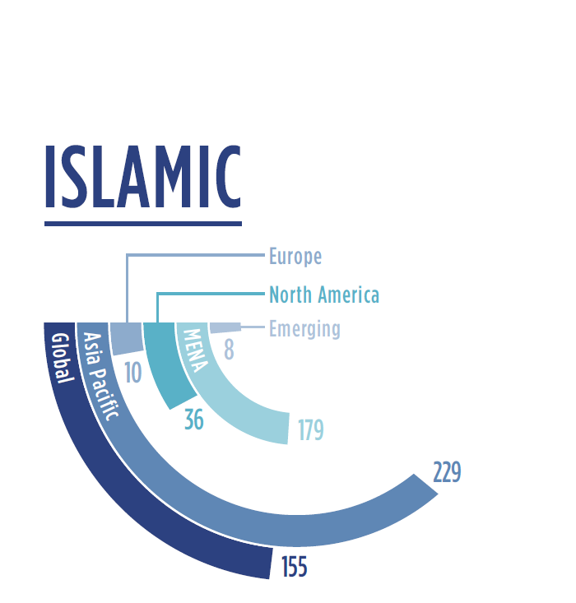

Slide 62
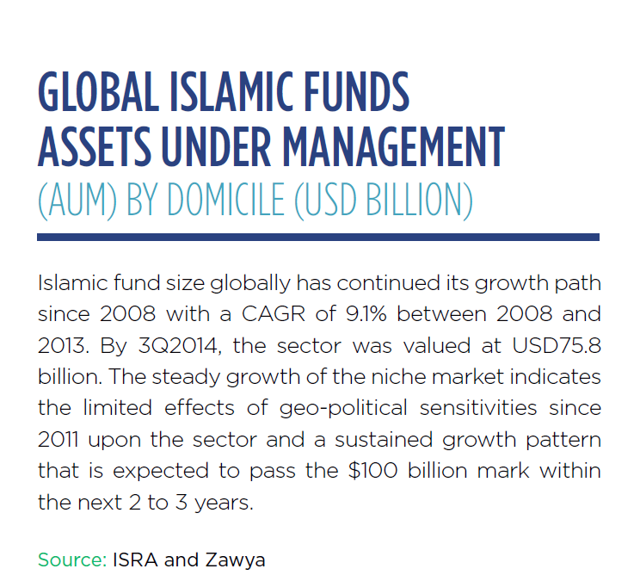

Slide 63
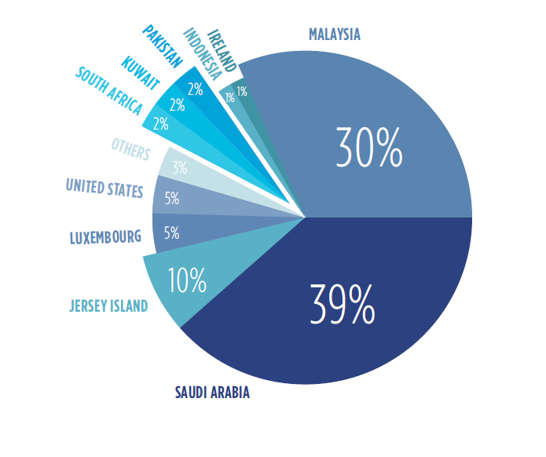

Slide 64
Enhance Social Responsibilty in
Islamic Banks
Set environmentally friendly policies, procedures and Business Practices
Monitor customers compliance with environmental standards
Support phlianthropic and social programmes
Observe and care impact of environmental and social activities

Slide 65
Enhance Social Responsibilty in
Islamic Banks
Set environmentally friendly policies, procedures and Business Practices
Monitor customers compliance with environmental standards
Support phlianthropic and social programmes
Observe and care impact of environmental and social activities

Slide 66
CONCLUSION
Wisdom is common for all humanity,
Merits of conventional finance and business as caring environment and being socially responsible is also virtue of Islamic Banking and Finance

Slide 67
Thanks ….
sensoynecdet@gmail.com
Necdetsensoy.Academia.edu

