Slide 2
Reflective Pronouns

Slide 3
A reflexive pronoun refers to a noun or another pronoun and indicates that the same person or thing is involved.
Reflexive pronouns are formed by adding –self and –selves to certain personal and possessive pronouns.
The woman found herself a book of folktales.
Reflexive pronoun
We can also use reflexive pronouns for emphasis (as “intensive pronouns”).
For example, “I did the homework myself” emphasizes the fact that nobody helped me to do my homework.

Slide 4
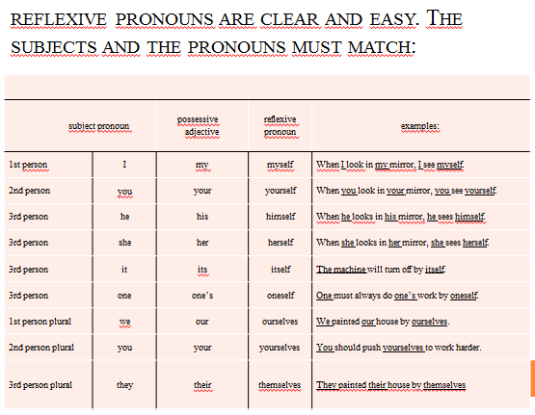

Slide 5
In English, the reflexive pronouns are not used to indicate a reciprocal relationship. In this case, rather, we use each other. There are two people and the sama action is directed at both of them.
Example:
We see each other. (not: We see ourselves.)
1. I help you and you help me. → We help each other.
2. She knows him well and he knows her well. → They know each other well.
3.Julia loves Frederic and Frederic loves Julia. → They love each other.
4.Bill and Steven have had an argument. Bill doesn't speak to Steven and Steven doesn't speak to Bill. → They don't speak to each other.
5.My husband trusts me and I trust him. → My husband and I trust each other.

Slide 6
Complete each of the sentences below.
1. My brother likes to practice his English by talking to ______________________.
2. James wasn’t careful and he cut ______________________ with a knife.
3. My sister and I looked at ______________________ in the mirror.
4. The repair shop was closed, so I fixed the car ______________________.
5. Did you enjoy ___________________________ at the party last night?
6. Cats can get clean by licking ___________________________.
7. (A) Did the cleaners cleaned the house? (B) No, I did it ______________________!
8. Mr. Smith burned ______________________ while he was cooking.

Slide 7
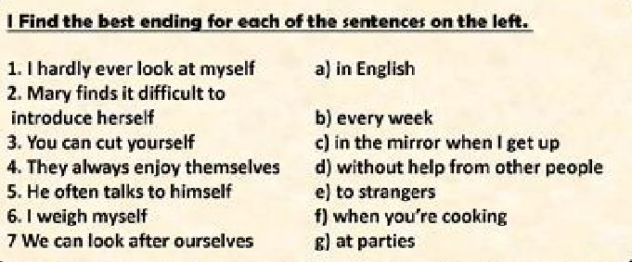

Slide 8
Complete the following sentences using appropriate reflexive pronouns.
1. Franz always asks _______________ why English is so crazy.
2. I consider _______________ to be an intelligent person.
3. The computer will reboot _______________ after the program installation.
4. Jörg and Birgit drive _______________ to work every day. They don't take the bus.
5. Sonja cleans her room by _______________. She never asks for help.
6. We are going to repair our house by _______________.
7. You and your coworker must finish on this project _______________.
8. I will finish these questions by _______________.
9. Tom saw a reflection of _______________ in the mirror.
10. Rita thought about killing _______________, but she realized it was wrong.
11. I _______________ will fax the report.
12. The man on the news accidentally shot _______________ in the foot.
13. We enjoyed _______________ at the seaside.
14. He drove _______________ to the airport yesterday.
15. She lives in that big, old house by _______________.

Slide 9
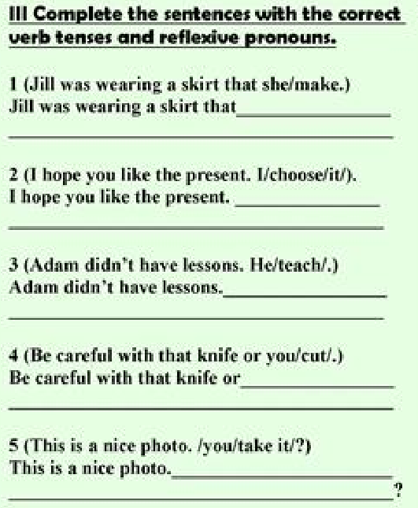

Slide 10
Choose either a reflexive pronoun or "each other" for each question.
1. There was an angry argument as the two sisters blamed ______ for the accident.
a) each other b)themselves
2. We took the wrong path and got ______ completely lost.
a) each other b) ourselves
3. How long have you and Sara known ______?
a) each other b)yourselves
4. Do you give ______ presents at Christmas in your country?
a) each other b)yourselves
5. Your brothers drink too much beer. They will make ______ ill.
a) each other b) themselves
6. Your hair is beautiful, Kate said as the two sisters looked at ______ in the mirror.
a) each other b) themselves
7. The managers in this company are very selfish and only think of ______.
a) each other b) themselves
8. The couple sat in the corner during the party, talking to ______ about their problems.
a) each other b)themselves

