Slide 2
REAL & UNREAL CONDITIONS

Slide 3
When do we use Real Conditions?
We use real conditions to express situatons that usually happen in the present or future. . Ex:If I do sports, I stay fit. . (meaning: I stay fit whenever I do sports.) . Ex: If I study hard, I will pass the exam. . (meaning: depending on my studying hard,I have the chance to pass the exam in the near future.)

Slide 4
When do we use Unreal Conditions?
We use the unreal conditions in two different times, which are present unreal and past unreal conditions
Present unreal conditons express situations in the present that are not true or real. Ex: If I had time today, I would go to the gym. (meaning: I don’t have time today, so I can’t go to the gym.) Ex: If I were you, I would go to the party. (meaning: I just imagine that I am in your place and I want to go to the party in that case.)

Slide 5
Past unreal conditions describe unreal past events with unreal past results. Ex: If you had come on time, we would have caught the bus. (meaning: You didn’t come on time, so we missed the bus.) Ex: If Sheila had been at school yesterday, she would have taken the exam. (meaning: Shelia wasn’t at home yesterday, so she couldn’t take the exam.)

Slide 6
FORM: Real/ Unreal Conditionals
 | If clause | Result clause
Present Real | If you see her, Simple Present | say hello. Simple Present
Future Real | If your plane is late, Simple Present | I will wait for you. Will + V1
Present Unreal | If I were you, Simple Past | I would leave. Would + V1
Past Unreal | If I had seen her yesterday, Past Perfect (had + V3) | I would have asked her something. Would have +V3

Slide 7
EXERCISES

Slide 8
Interactive Exercises
*
Listen to the dialogue and circle the things that people mention that they would do if they won the lottery.
Quit his job.
Buy an airplane
Buy a big house.
Travel.
Eat in expensive restaurants.
Buy a hotel.

Slide 9
Complete the sentences by using the correct if clause
If you sit in the sun too long especially in summer, ____________________________
If I were you, __________________________________________________________
If I were the Prime Minister, ______________________________________________
If she had studied harder for the exam, _____________________________________
If I won the lottery, _____________________________________________________
If I hadn’t gone to bed so late last night, _____________________________________
If I hadn’t come to London for learning English, _______________________________
If you mix water and electricity, ___________________________________________
If she sits at home because of the Corona virus, ______________________________

Slide 10
I would go on holiday if ___________________________________________________
My brother would have been happy if _______________________________________
I don’t eat anything if ____________________________________________________
We would cancel the organization if _________________________________________
Nobody would have seen us last night if ______________________________________
I will spend most of my money on clothes and shoes if __________________________
My parents don’t talk to me if ______________________________________________
My friend would have broken his arm while riding a bike if _______________________
I would call the doctor if __________________________________________________

Slide 11
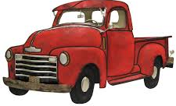
Mystery of the Red Truck
It has been confirmed that late on the night of the sixth of July, a large red truck ran into the bakery on Maryland Street. After an initial investigation by police, it is now clear that the truck had no driver at all. The locals are asking a simple question: “Where was the driver?” If the police want to solve this mystery, they will need the CCTV footage from the street. One of the locals said: “We’re all quite worried about a truck with no driver. This truck has never been seen in the neighborhood before. If we’d seen that truck before, we’d solve this mystery now.” Many locals share the same concerns. They want to know what’s happening in their town.
A witness at the crime scene told police: “There was a loud noise coming from the truck while it was going towards the building and its speed.... it was unbelievable. If it had been going slower, I would’ve had a chance to see the driver. But all I saw was the truck speeding into the bakery as fast as it could.’’
The police have already spoken with eleven other residents but no one knows any further details about the incident. Superintendent Amanda Slippers remarked: “This is a tough case. The truck license plate belongs to this town, but nobody has seen it here. According to the town records, the owner of the truck moved away from here years ago. No one knows where to. If we located the owner, we'd probably solve this mystery.
If a truck moves, then it has a driver. Well, maybe we should change this basic assumption on account of this mysterious red truck.

Slide 12
Decide if the statements are true or false according to the text.
The locals knew that the red truck had an old driver. ___________________
The police have investigated all the people in the town. _________________
The CCTV footage of the street will help the police._____________________
The locals haven’t seen the truck in the town before. ___________________
The truck ran into the building very slowly. ___________________________
CCTV: Closed Circuit TV, which can be utilized to view specific places in streets

Slide 13
Put the verbs in brackets into their correct tense
The burglars ___________________ (NOT DO) so much damage if you had locked all the drawers.
If he had slipped, he __________________________ (FALL) 500 metres.
They would have forced their way into the house if I __________________ (NOT CALL) for help.
You ___________________ (NOT BE) of any use to me unless you learn to type.
If I ____________________ (NOT BE) so busy yesterday, I would have invited him earlier.
If he ___________________ (STOP) smoking, he would put on some weight.
I ______________________ (BRING) you something to drink if I had known that you were thirsty.
You´ll get a cold if you ____________________ (NOT CHANGE) your wet clothes.
If I ____________________ (BE) president I would raise the taxes at once.
If a thief _________________ (ATTACK) me, my dog will jump at him quickly.
I´ll probably get lost unless he _______________________ (COME) with me.
I could repair the roof myself if I _____________________ (HAVE) a ladder.
If people didn’t have cars, they ______________________ (WALK).

Slide 14
Multiple Choice What is the correct answer?
1. If I had had enough money, I ----------------that radio. a. bought b. would buy c. would have bought d. had bought
2. If it rains, you ------------------- wet. a. will get b. would get c. get d. had got
3. She would go to the Job Centre if she------------ a job. a. had wanted b. will want c. wanted d. wants
4. The dog ------------- you if it hadn´t been tied up. a. would bite b. will bite c. would have bitten d. bites
5. It ----------------- easy to paint pictures if you knew how to. a. would be b. had been c. would have been d. be
6. If I come, I ------------------------ you. a. saw b. would see c. will see d. sees
7. She------------------------ pleased if you came. a. would be b. would have been c. would has been d. was
8. If it ----------------------- I would stay at home. a. rains b. rained c. has rained d. had rained

Slide 15
Choose the correct option.
He’s very determined to succeed. If an opportunity …. for him, he….. for it. a) rises/goes b) rises/ ’ll go c) rose/ ’d go
If the machine …….. immediately, just ….. the lever manually. a) didn’t start/turn b) doesn’t start/turn c) didn’t start/turned
I’m broke after a shopping day again. If I …… so much money on clothes, I ….. some more money now. a) didn’t spend/ ’d have b) don’t spend/will c) hadn’t spent/ ’d have
My neighbors were really annoying people. If I …… from there, I……… in a psychologist. a) didn’t move/ ’d end up b) don’t move/will end up c) hadn’t moved/’d have ended up
My exam results are terrible. If I ……. more, I …….at least a few lessons in the exam. a) had studied/could have passed b) studied/would pass c) studied/could have passed

Slide 16
If you …… me a hand to finish my work on time, I……..you my game console. a) give/lend b) give/will lend c) gave/would lend
I’m studying chemistry right now. If I …… enough time, I ….. you tonight. a) had/would call b) have/will call c) have/call
I didn’t get any invitation to the party. If I ….. an invitation now, I……..to that party. a) had/ ’d go b) have/will go c) had had/would have gone
If Emily ….. a good student, she ………. for the exam yesterday. a) were/would study b) were/studied c) was/would have studied
Please …… him that he needs to call Mary if you ……. to see him.. a) tell/happen b) will tell/happen c) tell/happened

Slide 17
When do we use unless clauses?
Unless means if not. We use it in conditional sentences instead of if not.
Unless can be used with present, past and past perfect tenses. Use unless with present tenses when talking about the future.
You will damage your health unless you stop smoking. = you will damage your health if you do not stop smoking.( Present)
Unless she helped me, I wouldn’t trust her. = If she did not help me, I wouldn’t trust her. (Past)
I wouldn’t have passed the test unless I had studied enough.. = If Ihad not studied enough, I would not have passed the test. (Past Perfect)

Slide 18
Choose the correct answer (if or unless)
_______________ you help me, I'll be unable to do it .
_______________ I meet him, I'll tell him the whole truth.
You won't get well ____________ you stop smoking.
__________ you exercise regularly, you won't be able to lose some weight.
__________ you exercise regularly, you'll lose some weight.
The teacher will be furious __________ you don't the homework.
You can't go on vacation ____________ you don't save some money.
You will feel cold ____________ you wear a warm jacket.
We'll arrive on time ___________ we hurry.
Don't call me ___________ it's an emergency.

Slide 19
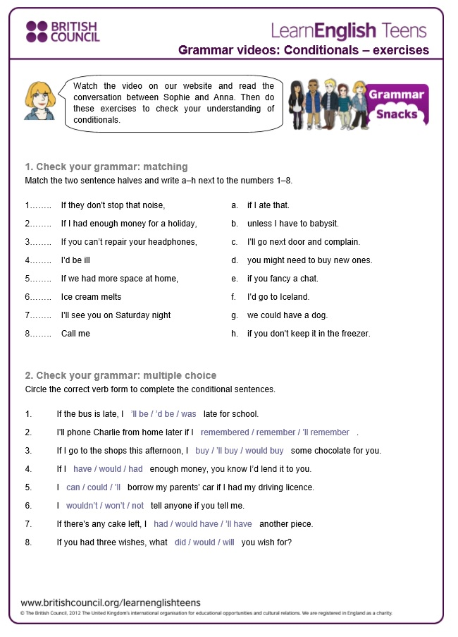

Slide 20
